Slide 1
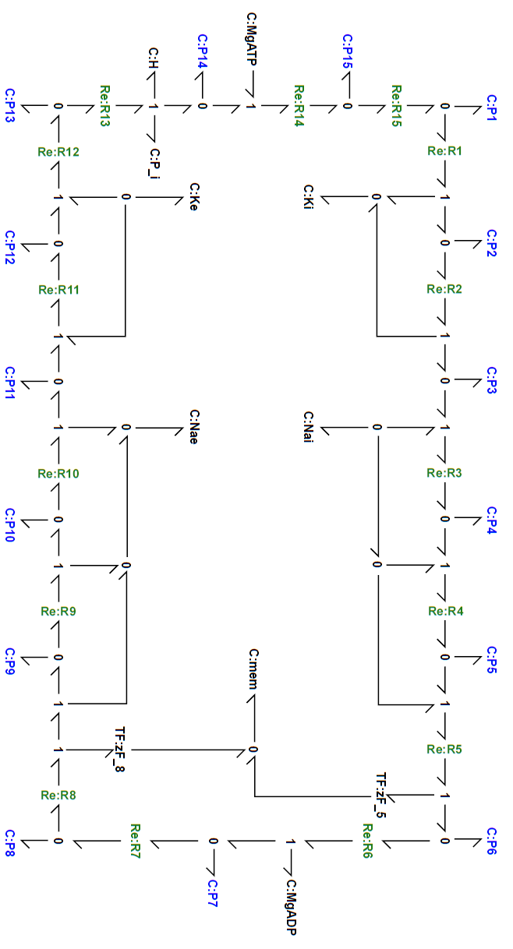












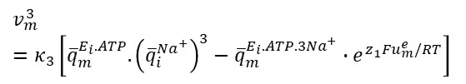




























$$q_{i}^{P_{i}}$$
Mass balance:
$$q_{i}^{ATP}$$
$\frac{d}{dt}q_{m}^{E_{i}.2K^{+}.ATP}=v_{m}^{15}−v_{m}^{1}$
$$\frac{d}{dt}q_{i}^{K^{+}}=2v_{m}^{1}$$
$$q_{m}^{E_{o}.P_{i}.2K^{+}}$$
$$v_{m}^{13}$$
$${Re}_{m}^{13}$$
$$v_{m}^{13}$$
$$q_{m}^{E_{o}.2K^{+}}$$
$$v_{m}^{15}$$
$${Re}_{m}^{15}$$
$$v_{m}^{15}$$
$$q_{m}^{E_{i}.2K^{+}.ATP}$$
$\frac{d}{dt}q_{m}^{E_{i}.ATP}=v_{m}^{1}−v_{m}^{3}$
$$\frac{d}{dt}q_{o}^{K^{+}}=−{2v}_{m}^{8}$$
$$v_{m}^{1}$$
$$q_{i}^{H}$$
$$\frac{d}{dt}q_{i}^{{Na}^{+}}=−{3v}_{m}^{3}$$
$${Re}_{m}^{1}$$
2
$$q_{i}^{K^{+}}$$
$$\frac{d}{dt}q_{o}^{{Na}^{+}}={3v}_{m}^{8}$$
$$q_{o}^{K^{+}}$$
$$v_{m}^{1}$$
$\frac{d}{dt}q_{i}^{ATP}=−v_{m}^{15}$
$\frac{d}{dt}q_{m}^{E_{i}.ATP.3{Na}^{+}}=v_{m}^{3}−v_{m}^{6}$
$\frac{d}{dt}q_{i}^{ADP}=v_{m}^{6}$
$\frac{d}{dt}q_{m}^{E_{i}.P_{i}.3{Na}^{+}}=v_{m}^{6}−v_{m}^{8}$
$\frac{d}{dt}q_{i}^{P_{i}}=v_{m}^{13}$
$\frac{d}{dt}q_{i}^{e}=z_{1}Fv_{m}^{5}+z_{2}Fv_{m}^{8}$
$$q_{m}^{E_{i}.ATP }$$
$\frac{d}{dt}q_{i}^{H}=v_{m}^{13}$
$$q_{o}^{{Na}^{+}}$$
$$v_{m}^{3}$$
3
$$q_{i}^{{Na}^{+}}$$
$${Re}_{m}^{3}$$
$\frac{d}{dt}q_{m}^{E_{o}.P_{i}.2K^{+}}=v_{m}^{8}−v_{m}^{13}$
$$v_{m}^{3}$$
$\frac{d}{dt}q_{m}^{E_{o}.2K^{+}}=v_{m}^{13}−v_{m}^{15}$
Reaction fluxes
$$v_{m}^{1}=κ_{1}\left[{\overline{q}}_{m}^{E_{i}.2K^{+}.ATP}−{\overline{q}}_{m}^{E_{i}.ATP}.{\left({\overline{q}}_{i}^{K^{+}}\right)}^{2}\right]$$
3
$$v_{m}^{8}$$
$$v_{m}^{3}=κ_{3}\left[{\overline{q}}_{m}^{E_{i}.ATP}.{\left({\overline{q}}_{i}^{{Na}^{+}}\right)}^{3}−{\overline{q}}_{m}^{E_{i}.ATP.3{Na}^{+}}{∙e}^{z_{1}Fu_{m}^{e}/RT}\right]$$
$${Re}_{m}^{8}$$
2
$$v_{m}^{8}$$
$$z_{2}F$$
$$u_{m}^{e}$$
$$z_{1}F$$
$$q_{m}^{E_{i}.P_{i}.3{Na}^{+}}$$
$$v_{m}^{6}$$
$${Re}_{m}^{6}$$
$$v_{m}^{6}$$
$$q_{m}^{E_{i}.ATP.3{Na}^{+}}$$
$$q_{i}^{ADP}$$
$$v_{m}^{6}=κ_{6}\left[{\overline{q}}_{m}^{E_{i}.ATP.3{Na}^{+}} −{\overline{q}}_{m}^{E_{i}.P_{i}.3{Na}^{+}}.{\overline{q}}_{i}^{ADP}\right]$$
$$v_{m}^{8}=κ_{8}\left[{\overline{q}}_{m}^{E_{i}.P_{i}.3{Na}^{+}}{\left({\overline{q}}_{o}^{K^{+}}\right)}^{2}−{\overline{q}}_{m}^{E_{o}.P_{i}.2K^{+}}.{\left({\overline{q}}_{o}^{{Na}^{+}}\right)}^{3}.e^{z_{2}Fu_{m}^{e}/RT}\right]$$
$$v_{m}^{13}=κ_{13}\left[{\overline{q}}_{m}^{E_{o}.P_{i}.2K^{+}} −{\overline{q}}_{m}^{E_{o}.2K^{+}}.{\overline{q}}_{i}^{P_{i}}{\overline{q}}_{i}^{H}\right]$$
$$v_{m}^{15}=κ_{15}\left[{\overline{q}}_{m}^{E_{o}.2K^{+}}{\overline{q}}_{i}^{ATP}−{\overline{q}}_{m}^{E_{i}.2K^{+}.ATP} \right]$$

